Slide 1

Contact Book
Jenn rawlins Nov 13 2017

Slide 2
GOALS
PROJECT APPROACH
ARCHITECTURE OVERVIEW
DEMO & CODE REVIEW

Slide 3
PROJECT GOALS
POC
Demonstrate client approach
Easy to use minimum viable project
CODE
Demonstrate best practices
Show breadth and depth

Slide 4
CLIENT POC GOALS
QUICK WIN
USABLE PRODUCT
FLEXIBLE ARCHITECTURE
FIND QUESTIONS
GATHER REQUIREMENTS

Slide 5
PROJECT APPROACH
REVIEW EXISTING
Outlook.live.com - People
Google – Contacts
MVP (Minimum Viable Project)
UI Sketch -> Fields, Layout, Flow
Architecture Design and Technologies
Feature List

Slide 6
DOING NOT DOING
SHOW FULL STACK
UX DESIGN
BASIC TESTING
SIMPLE SQL SCHEMA
SERVER VALIDATION
AUTHENTICATION
COMPLEX THEME
AUTOMATED INTEGRATION TESTS
MOBILE == DESKTOP
CLIENT VALIDATION

Slide 7
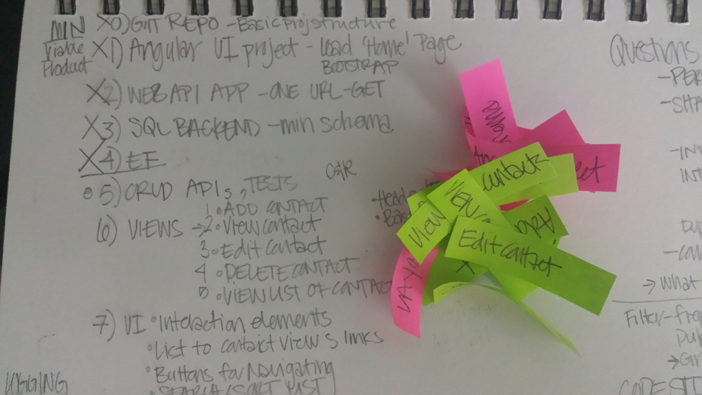
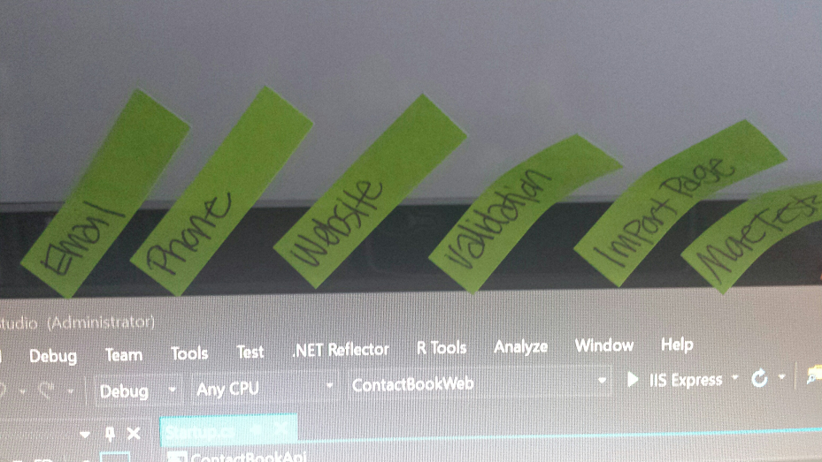
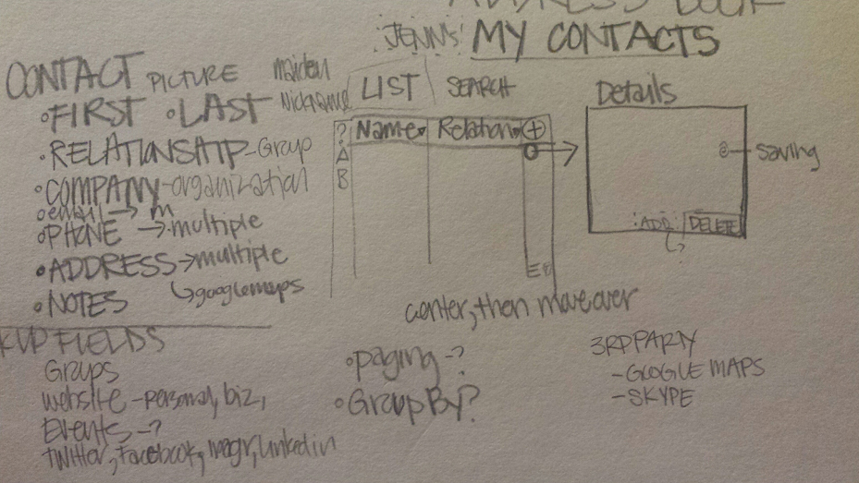
Super fancy project tracking & storyboarding

Slide 8
3 -TIER ARCHITECTURE
ANGULARJS SPA
ASPNETCORE MVC
ASPNETCORE API
ENTITY FRAMEWORK
MSSQL

Slide 9
TECHNOLOGY
ANGULARJS
Comfortable, know best practices
Growth: Separate project – replace easily
ASPNETCORE and EF CORE
Newer, but wave of the future
Growth: Docker Container, Azure Web App, Linux
MSSQL
Because I love it
Growth: Azure SQL Database service

Slide 10
TOOLS
VISUAL STUDIO 2017
MSSQL 2017
POSTMAN
CHROME
MSTEST
T-SQL SCRIPT create/restore
KESTREL /w IIS EXPRESS as reverse proxy

Slide 11
DEMO & CODE REVIEW

